Slide 1

Networks of the future

Slide 2
Today’s Network
Queuing delay
  Delays to the arrival of the packets on account of network congestion
Transmission delay
  A delay caused by a first come, first serve system, where it has to wait its turn in order to transmit itself
Packet loss
  A packet is dropped due to a full buffer
Throughput
  The amount of data per second that can be transferred. Often constrained, because not every system can handle instantaneous transmission
Processing delay
  The time it takes to look at a Packet’s header and determine where to send it. May also include looking for bit-level errors
Propagation delay
  How long it takes the bits to travel through wires, doing so at the speed of light
Bottleneck links
  A link along the end-to-end paths, and the first to experience congestion loss.
Network congestion
  The loss of packets and increased delay caused by too much data being sent at too high a rate.
Notes:
WE’VE BEEN THROUGH THE ONES ON THE LEFT LAST VIDEO
Delays may be a result of network congestion, which leads to packet loss
Because delay is made up of so many little things, simply increasing the speed of one component doesn’t eliminate network delay, congestion, or packet loss

Slide 3
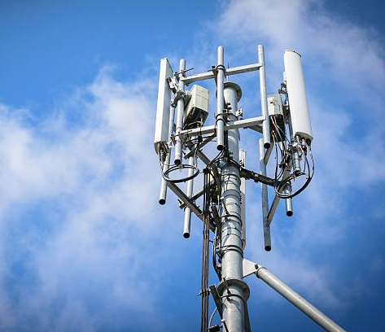
Future Improvement:
6g
Throughput
Network Congestion
Notes:
6G will improve Throughput/amount of data that can be transferred at once, in turn decreasing network congestion as well as delays

Slide 4
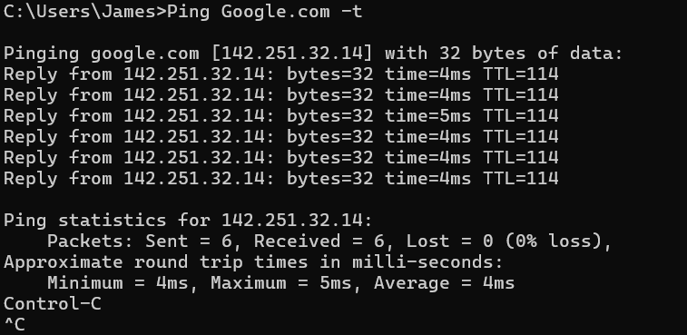
Observing the current internet
Left <– a ping test run on my own computer, a protocol that measures delay and allows for the guessing of throughput. It routes a Ping Packet to a destination. Upon arrival, a Pong Packet is echoed back.
With AI-Routing, this could be even faster, and much greener too!
Notes:
• Screenshot of the experiment
Above
• Explanation of what was measured
The ping for travelling to google.com (aka the time it takes to send a “Ping Packet” there, and receive the “Pong Packet” back
• Interpretation of the results
It took only 4 milliseconds on average to reach
• Relationship to delay, routing, protocols, throughput, or packet behavior
This is a protocol that essentially measures Packet Behavior through it’s timing, sending them on routes, to measure the delay and estimate the throughput.
RESEARCH
Studies by the Institute of Electrical and Electronics Engineers (or IEEE) have shown that with AI alone, we could make our networks faster with the ability to predict and manage traffic, and that these could even lead to a greener internet

Slide 5
AI and the future of network optimization
This technology would be found in the network Edge.
Pros
Reduce latency in times of congestion
Improve security in a robust way
Can easily plan around various network traffic patterns
Cons
The AI has its own latency
It can also be used as a method of attacking networks
Will struggle with high levels of noise and irregularities in Network traffic data
  Anomalies could negatively impact data
Notes:
I do not care for AI in the slightest, however it’s hard to put the toothpaste back in the tube, and it can be used for some useful things IF applied right.
(list first 3 points)
The AI has latency of it’s own to run
It’s also a robust ATTACK method
Our internet has a LOT of noise and irregularities, something that AI has been shown to struggle with.
Even when set up, new Anomalies could influence its data, and lead to future incorrect decisions

Slide 6
Quantum networks and quantum-safe networks
Quantum Communication
  Communication with the use of Quantum Mechanics
Quantum information
  Information on the state of a Quantum system
Qubits
  A Quantum Bit
Photons
  Elementary particles used to transmit data
  Have been blamed for an odd warp in a 2013 speedrun of Super Mario 64
Quantum Entanglement
  A phenomena where two particles become linked, or entangled, regardless of distance.
Quantum Repeaters
  Keeps particles entangled while teleporting them to where they need to go
Quantum Networks
  Classical networks instead built with quantum variables and mechanics
The “Quantum Internet”
  Seen as the “final stage” of the Quantum revolution, able to perform actions not available in the current internet with no clear comparison, such as teleporting data

Slide 7
Quantum networks and quantum-safe networks cont.
Classical Network | Quantum Network
Classical bits | Qubits / quantum states
Traditional Repeaters | Quantum Repeaters
Packet Copying is possible | Cloning is more limited due to quantum mechanics
Classical routing concepts | Makes use of Teleportation
The current internet’s infrastructure | An experimental infrastructure that’s recently found some footing.
A strong security system must be developed before Quantum networks arrive, as many classical methods would either need to become larger, or would be no longer secure.
Post-Quantum Cryptography (or PQC) is Cryptography that works on both classical and quantum networks
The “backwards compatible” approach taken could secure our current networks, before quantum networking can even be fully implemented.

Slide 8
The blockchain and Decentralized Networking
Possible applications
Potential limitations
Significantly enhanced security, as records cannot be altered without the network’s other participants
Decentralized, as all participants, or at least their nodes, must come to a consensus on an action.
All users can see anything on the Blockchain, allowing for greater transparency and resource sharing.
Even if they can’t view the record, it’s easy to find its existence
Highly impractical for any constantly changing records
Nodes may receive misinformation or perform faulty or malicious behavior due to connection latency
Notes:
THIS IS NOT ABOUT CRYPTO
- Blockchain is where a record, or “block”, cannot be altered without the agreement of all participants
- Nature of the blockchain offers significantly enhanced security, which can be beneficial for many fields such as Healthcare and the Military

Slide 9


Encapsulation: does it still matter?
It depends
Certain new technologies won’t immediately antiquate Encapsulation, as they merely build off our current internet.
Others potentially will, given they change up some of the building blocks of how we use the internet
Message → Segment → Datagram/Packet → Frame → Bits
Application → Transport → Network → Link → Physical
Notes:
Start with a application-layer Message
Grouped with transport layer header to create a segment to be sent
Said segment is placed within a network-layer Packet, or Datagram
The packet is then encapsulated by a link-layer header to create the frame
All of this is sent as bits across the internet
New technologies such as AI, 6G can live alongside Encapsulation, as they mainly make the current internet faster and more efficient
Others, such as Blockchain or Quantum networking will, given their drastic changes to how the internet works. No need to disguise a message for its trip across the internet if the data’s just teleported from place to place

Slide 10
From arpanet to the future internet
Packet Switching → ARPAnet → ALOHAnet → NCP → First E-Mail → Cerf and Kahn’s Internetworking principles → TCP/IP → DNS → World Wide Web (WWW) → Broadband → Wi-Fi → Cloud → Smartphones → 4G → 5G → SDN → 6G → Edge Computing → AI Native Networks → Post-Quantum Security
In 1961 Kleinrock shows effectiveness of packet-switching through the Queueing theory
ARPAnet conceived in 1967, with ALOHAnet iterating on the idea in 1970
1972 sees the first NCP host-host protocol and the first email
Cerf and Kahn introduce the architecture that comes to define our modern networks in 1974
The 80s give us DNS, TCP, and the WWW in ‘83, ‘88, and ’89
Come 2005, Broadband and future improvements define the way we all connect to the internet, and where we can do so.
No Edge computing or beyond… yet.
Notes:
Packet Switching is what acted as the foundation for the internet, which was iterated on by ARPAnet, and later ALOHAnet
(NCP is Network Control Program)
C&K came to define today’s internet architecture
Transmission Control / Internet Protocols
Domain Name System, turns names into IP addresses
Broadband helped give homes access (very aggressive)
We are currently at SDN or Software-Defined Networking.
Personally, I’m not sure we’ll achieve true wide-spread quantum computing, what with everything that needs to go into it, at least not in our lifetimes, or course that’s only my own prediction.
Now, as for the one I believe will cause the greatest change in networking in the next 10 years is likely AI Native Networks. AI on it’s own has already proved to be revolutionary within multiple industries, especially with the sharp rise of “Vibe coding”. So, with the AI now built into the Internet itself, It’s hard to imagine a similar process won’t follow. There’s also it’s previously stated quirks, which may necessitate the creation of special “walls” built around them to stop them from potentially going off the rails.

Slide 11


One future technology
6g
Massively improves many aspects of 5G
  10⁶ → 10⁸ devices/km²
  20 GHz → 3 THz Bandwidth
  100x Network Energy Efficiency
6G allows for Cell-less Networks, Disruptive Technologies, and a New Spectrum
We still lack a good way to fully utilize everything 6G would offer
Would be in the Link Layer of Network Architecture
Studies and Specifications of it have already begun, it is currently expected to be deployed as a product in Early 2028
Strengthens current plans, and opens the doors to even more developments, such as Blockchain or an Industrial Internet of Things
Notes:
Drastic improvement over 5G, from density of connections, Latency, Bandwidth, Data Rate, Mobility, and Energy Efficiency
According to a 2019 study performed on the roadmap of 6G by members of IEEE, Study of 6G has already ended, determining specifications are ongoing, and they predict it’ll launch around early 2028.
The main limitation is our own tech, we just don’t have what we need to fully utilize 6G
Would provide a huge impact, given just how digital or “smart” many things are becoming. Phones, Cars, Fridges. It also opens the door to even more new developments

Slide 12
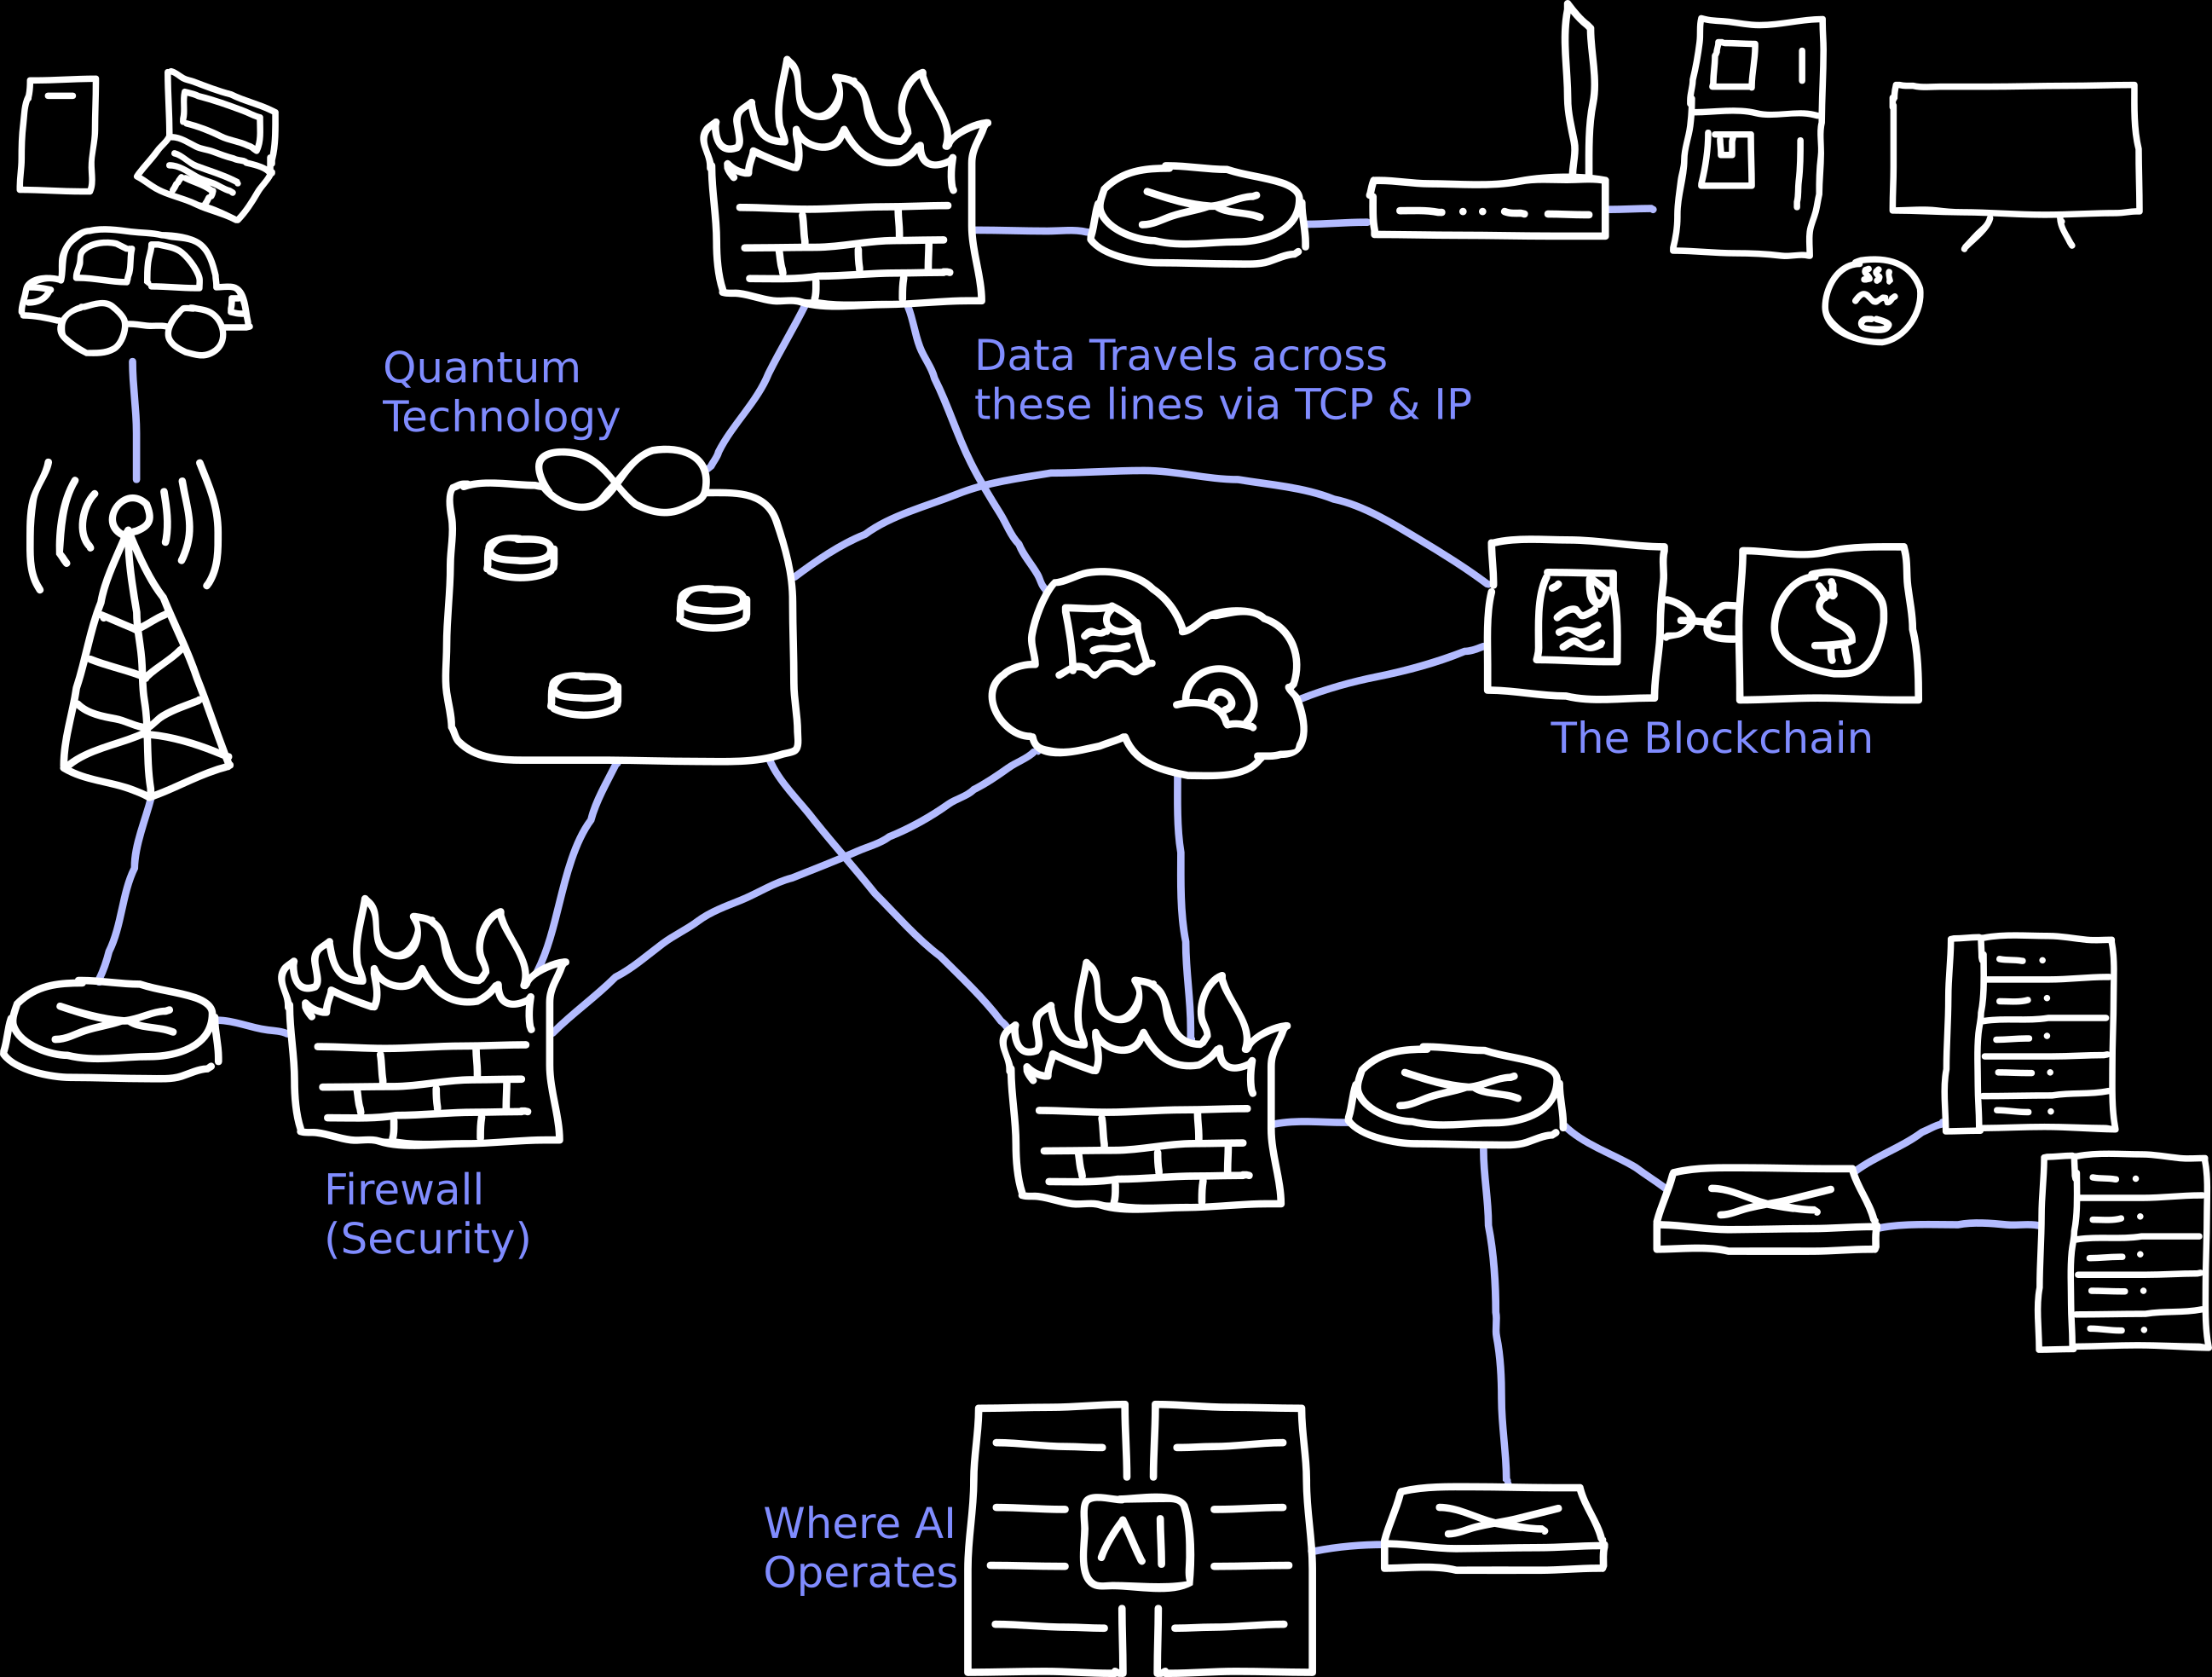
The future network architecture challenge
A hypothetical network in 2035
  Existing Technology
    Devices (User, IoT, Edge)
    Routers
    Cloud
    Cybersecurity Services
    Blockchain
  Emerging Technology
    AI Network Controller
  Experimental Technology
    6G
    Quantum Communication / Networking
Notes:
The pictured Diagram is one of my own design, meant to represent a hypothetical network in 2035.
Right now, we have Devices, Routers, and the cloud (You’re already using all three in tandem right now to watch this)
Cybersecurity is something that’s existed for years, many of us were taught it in school
The blockchain, even if it’s mainly used on less helpful things like Cryptocurrency or NFTs, exists
AI, while it does exist, isn’t quite in the state to do some of the more complex things we want it to do for controlling networks. Furthermore, it needs 6G, which is itself still experimental, not yet having released anywhere.
Quantum, meanwhile, is still all mostly hypotheticals for, thus it’s only Experimental.

Slide 13
Research Comparison Matrix
Technology | Networking Problem Addressed | Network Area/Layer | Major Benefits | Major Limitation | Current Status
AI | Traffic and Congestion | Transport | Can predict and work around congestion, reducing packet loss | Its dataset can easily be influenced for the worse by anomalies | Emerging
Quantum Networking | Advances the internet via Quantum Mechanics. | All | Teleportation | Things such as cloning become far more limited | Mostly Research
Post-Quantum Security | Possible security flaws of Quantum Networking | Transport | Increases the security of our current internet | Hard to account for the security of something not yet built | Emerging
Blockchain | Security of devices and the internet’s current centralized state. | Application | Hard to change anything stored | Hard to change anything stored | Deployed
6G | Range and effectiveness of 5G | Link Layer | Massive Improvement to 5G, and allows for more “new” Tech | Don’t quite have the tech yet. | Experimental

Slide 14
Works Cited
A. S. Cacciapuoti, M. Caleffi, F. Tafuri, F. S. Cataliotti, S. Gherardini, and G. Bianchi, “Quantum Internet: Networking Challenges in Distributed Quantum Computing,” IEEE Network, vol. 34, no. 1, pp. 137–143, 2020, doi: 10.1109/MNET.001.1900092.
C. T. Nguyen, D. T. Hoang, D. N. Nguyen, D. Niyato, H. T. Nguyen, and E. Dutkiewicz, “Proof-of-Stake Consensus Mechanisms for Future Blockchain Networks: Fundamentals, Applications and Opportunities,” IEEE Access, vol. 7, pp. 85727–85745, 2019, doi: 10.1109/ACCESS.2019.2925010.
H. Du et al., “Enhancing Deep Reinforcement Learning: A Tutorial on Generative Diffusion Models in Network Optimization,” IEEE Communications Surveys & Tutorials, vol. 26, no. 4, pp. 2611–2646, 2024, doi: 10.1109/COMST.2024.3400011.
H. Tataria, M. Shafi, A. F. Molisch, M. Dohler, H. Sjöland, and F. Tufvesson, “6G Wireless Systems: Vision, Requirements, Challenges, Insights, and Opportunities,” Proceedings of the IEEE, vol. 109, no. 7, pp. 1166–1199, 2021, doi: 10.1109/JPROC.2021.3061701.
J. F. Kurose and K. Ross, Computer Networking: A Top-Down Approach, 9th ed. London, England: Pearson, 2025.
K. B. Letaief, W. Chen, Y. Shi, J. Zhang, and Y.-J. A. Zhang, “The Roadmap to 6G: AI Empowered Wireless Networks,” IEEE Communications Magazine, vol. 57, no. 8, pp. 84–90, 2019, doi: 10.1109/MCOM.2019.1900271.
L. Chen et al., “Report on Post-Quantum Cryptography,” National Institute of Standards and Technology, Maryland, Apr. 2016.
M. Giordani, M. Polese, M. Mezzavilla, S. Rangan, and M. Zorzi, “Toward 6G Networks: Use Cases and Technologies,” IEEE Communications Magazine, vol. 58, no. 3, pp. 55–61, 2020, doi: 10.1109/MCOM.001.1900411.
R. Chataut, M. Nankya, and R. Akl, “6G Networks and the AI Revolution—Exploring Technologies, Applications, and Emerging Challenges,” Sensors, vol. 24, no. 6, 2024, doi: 10.3390/s24061888.
R. Etengu, S. C. Tan, L. C. Kwang, F. M. Abbou, and T. C. Chuah, “AI-Assisted Framework for Green-Routing and Load Balancing in Hybrid Software-Defined
Networking: Proposal, Challenges and Future Perspective,” IEEE Access, vol. 8, pp. 166384–166441, 2020, doi: 10.1109/ACCESS.2020.3022291.
R. Van Meter, “Quantum Networking and Internetworking,” IEEE Network, vol. 26, no. 4, pp. 59–64, 2012, doi: 10.1109/MNET.2012.6246754.
Stock Images sourced from iStock

